Slide 1
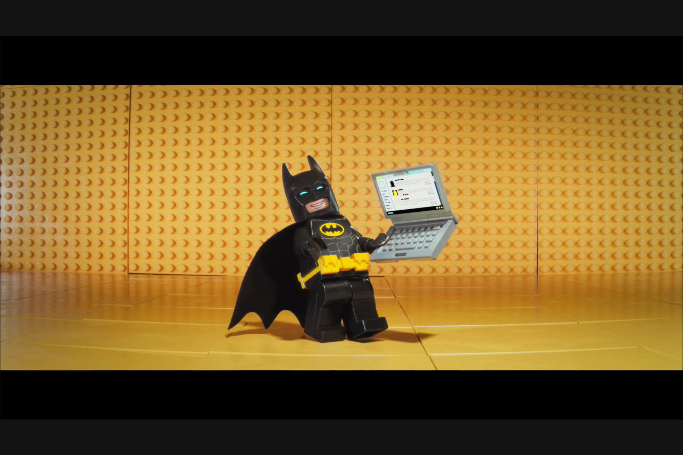
Coding Fun

Slide 2
Coding is fun
Software can be a really fun hobby or job
If you can dream it, you can make it
All you need is a computer and a brain

Slide 3
Control your world
More and more devices are programmable
How many devices in this room right now?
Learning to code means you can control more

Slide 4
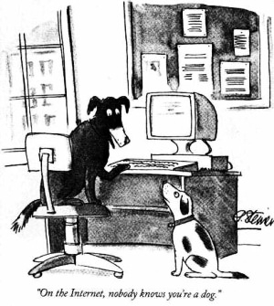
You can do real things…
The difference between “kid stuff” and “real stuff” is smaller than you might think.
You don’t have to learn it all at once.

Slide 5
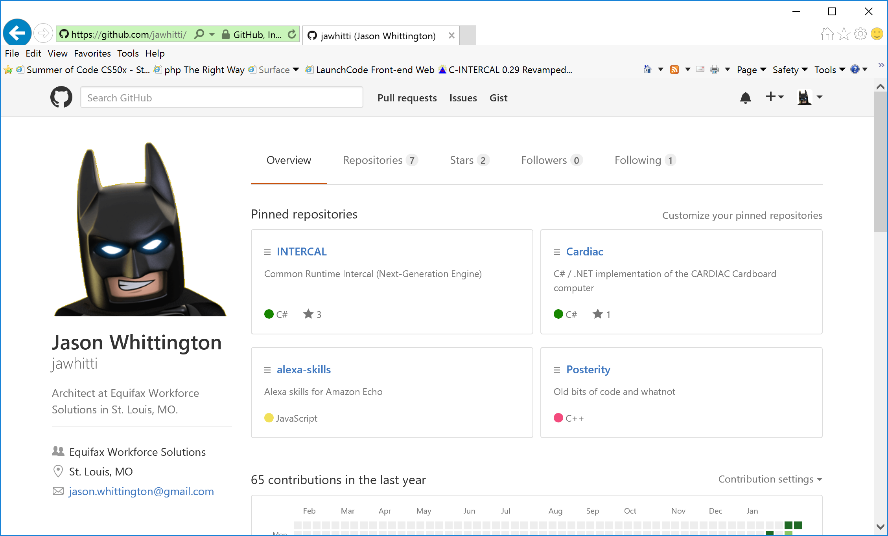
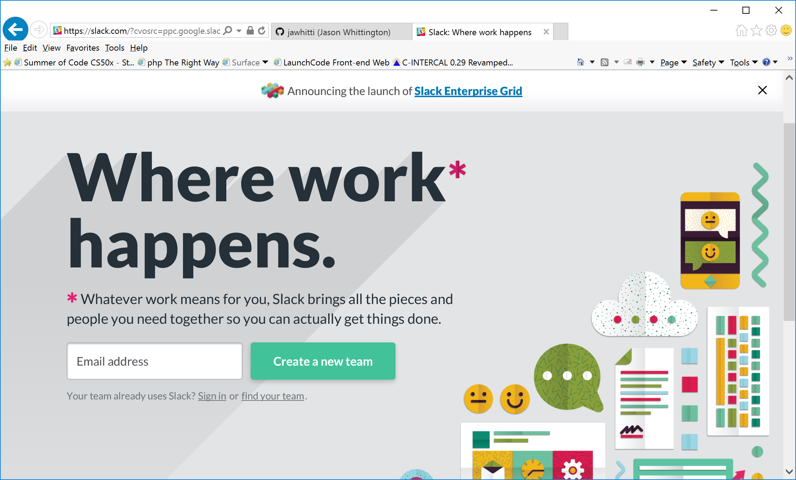
Coding is social
GitHub is a great to find and share code
Stack Overflow is a great place to ask questions
Slack lets you chat with other people writing code

Slide 6
Getting started
JavaScript is an easy place to get started
Easy to start learning
You can use it to do lots of things
Lots of websites will let you experiment for free
jsfiddle.net
https://www.tutorialspoint.com/try_javascript_online.php

Slide 7
Let’s write some code!

Slide 8
Questions?

